Slide 1
Exploration of Alternative GPU Implementations of the Pair-HMMs Forward Algorithm
Shanshan Ren, Koen Bertel, Zaid Al-Ars
2016 IEEE International Conference on Bioinformatics and Biomedicine (BIBM)

Slide 2
Background
Gene: A T C G, 碱基对bp (base pair)
人与人的基因序列中99.9%相同 30亿-300万
1. SNP: single nucleotide polymorphism 单核苷酸多态性
转换(transition)或颠换(transversion)
2. INDEL: 插入(Insertion) and 缺失(Deletion)
Next-Generation Sequencing (NGS): 高通量，短序列，高精度

Slide 3
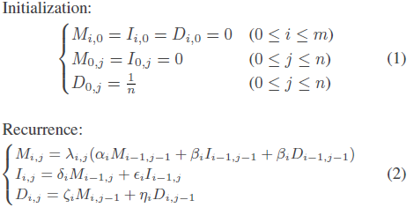
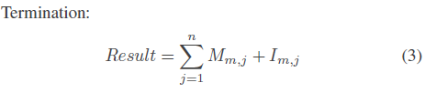
Pair-HMMs Forward Algorithm (PFA)
Calculate the overall alignment probability of two sequences
m: length of sequence R
n: length of sequence H
Mi,j: overall alignment probability of R1…Ri and H1…Hj
Iij: Ri aligned to gap
Dij: Hj aligned to gap
λi,j: emission probability
transmission probability

Slide 4
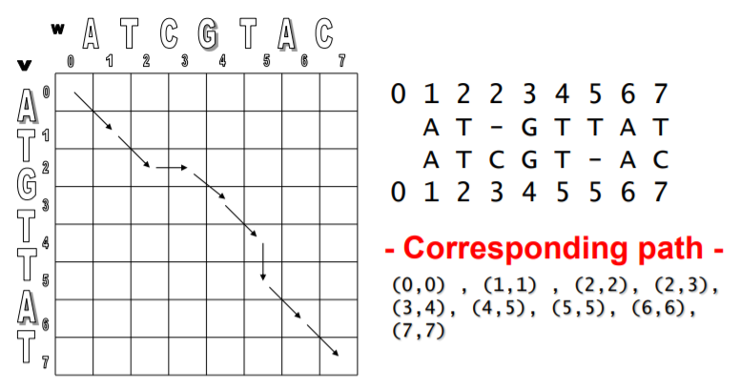
Pair-HMMs Forward Algorithm (PFA)

Slide 5
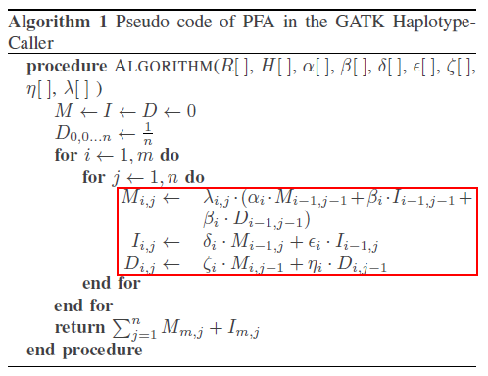
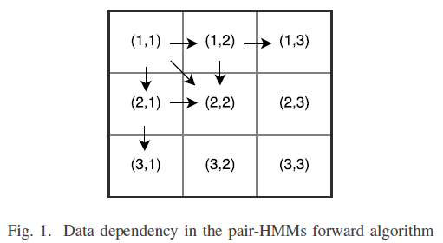
Pair-HMMs Forward Algorithm (PFA)
Two-layer loop
3 matrices: M, I, D
0(mn)
Inherent Parallelism

Slide 6
Two Acceleration Methods on GPUs
Inter-task Implementation
Map algorithm to a single thread
Parallel copies and independent threads
Coarse-grained
Intra-task Parallelization
Inherent Parallelism
map algorithm to a block
a single copy
O(m + n)

Slide 7
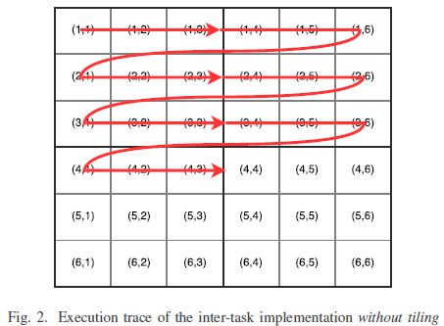
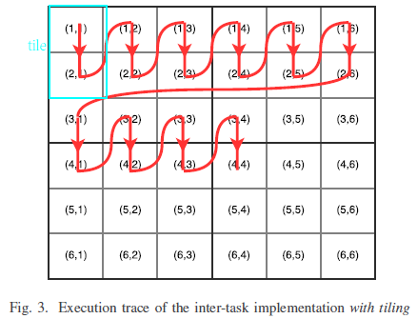
Inter-task Implementation
Naïve Implementation
Tile-based Implementation

Slide 8
Tile-based Implementation vs Naïve Implementation
优点：
6 global memory access → 3 global memory access
6*m*n → 6*m*n/k
缺点：
More registers and shared memory
scarce → limited tile size
Tile size k=1 naïve implementation

Slide 9
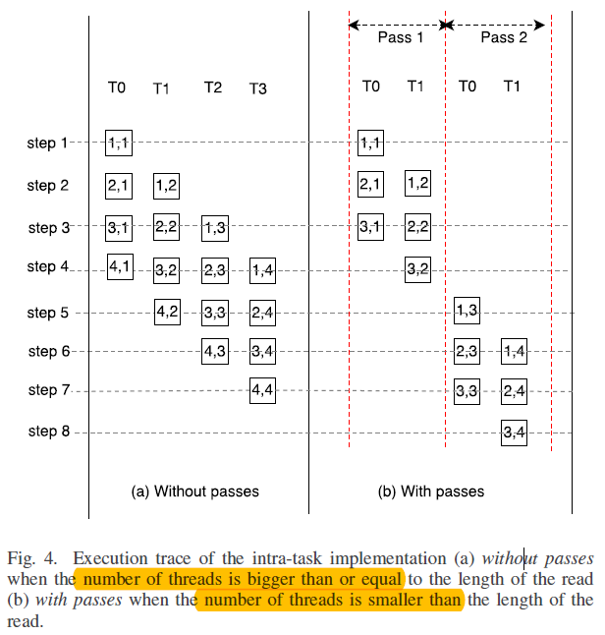
Intra-task Parallelization
Naïve Implementation
Inherent Parallelism: all threads in the same block parallel
Synchronization function after each step
m+n-1 steps/synchronizations
(a): shared memory
(b): global memory between pass

Slide 10
Intra-task Parallelization
Synchronization function:
threads stall and wait, lower GPU utilization efficiency
Reduce calls:
Warp-based implementation
Tile-based Implementation

Slide 11
Warp-based implementation
Threads in the same warp execute the same instruction at the same time –Synchronize!
Shuffle instruction instead of shared memory for data exchange among threads
Block size: 32, usually < length of the read sequence, Multiple Pass
Shared memory between path
small block size→ cannot fully utilize the resources
Improved Warp-based Implementation

Slide 12
Improved Warp-based Implementation
Block Size 128, 4 warps in each block
Each 32 threads implements PFA independently
缺点：Global memory → large latency

Slide 13
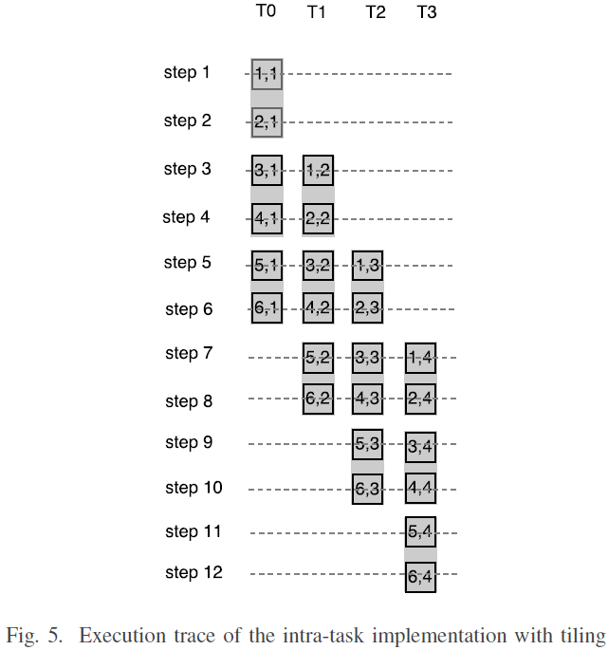
Tile-based Implementation
与Inter对比:
Reduce memory accesses
Reduce synchronization function calls
与naïve对比: for each step & thread
Value of element in each column
Value of elements in one tile in each column
m+n-1 synchronizations
m+n/k-1 synchronizations
Increase steps: m=4, n=6; 9 vs 12
More vectors in the shared memory for data exchange
between threads
Scarce shared memory → limited tile size

Slide 14
Intra-task Drawback
Cannot fully utilize the resources
Figure 4(a) Idle threads

Slide 15
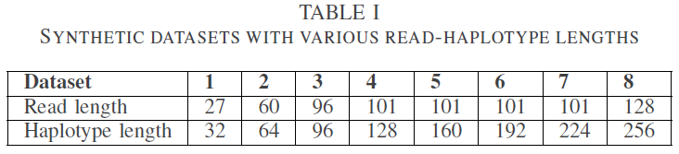
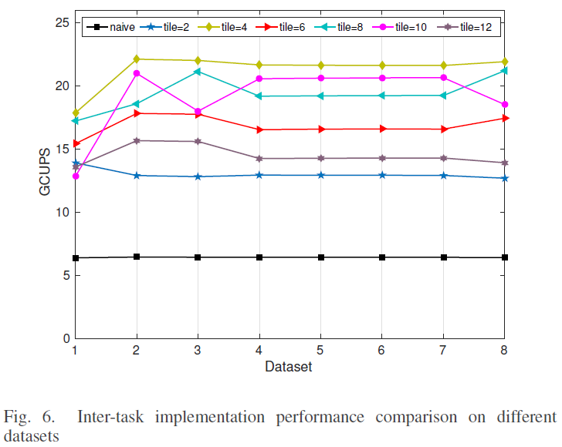
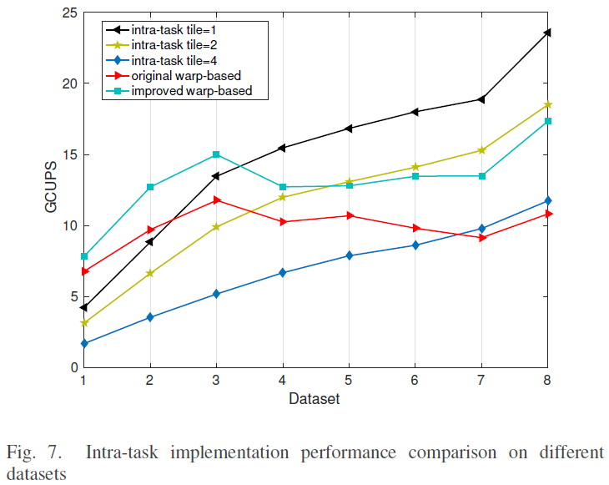
Results

Slide 16
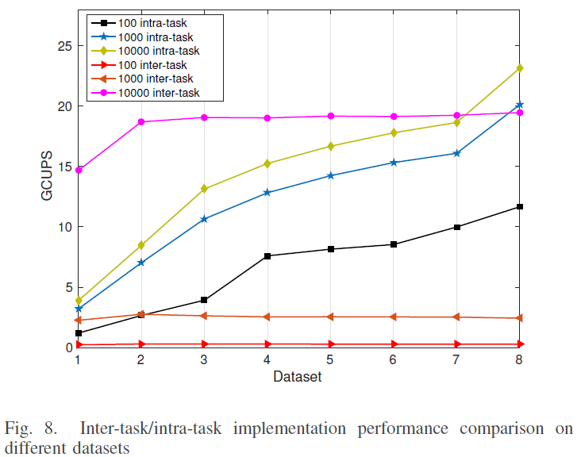
Results

Slide 17
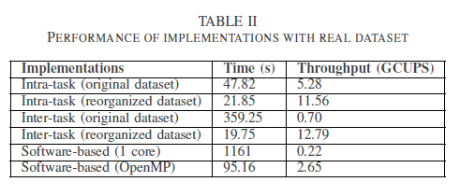
Results

